Slide 1

Flight Ticket Registration System
Review-2
Team member names:
Saptajit Banerjee 20BCE1513

Slide 2
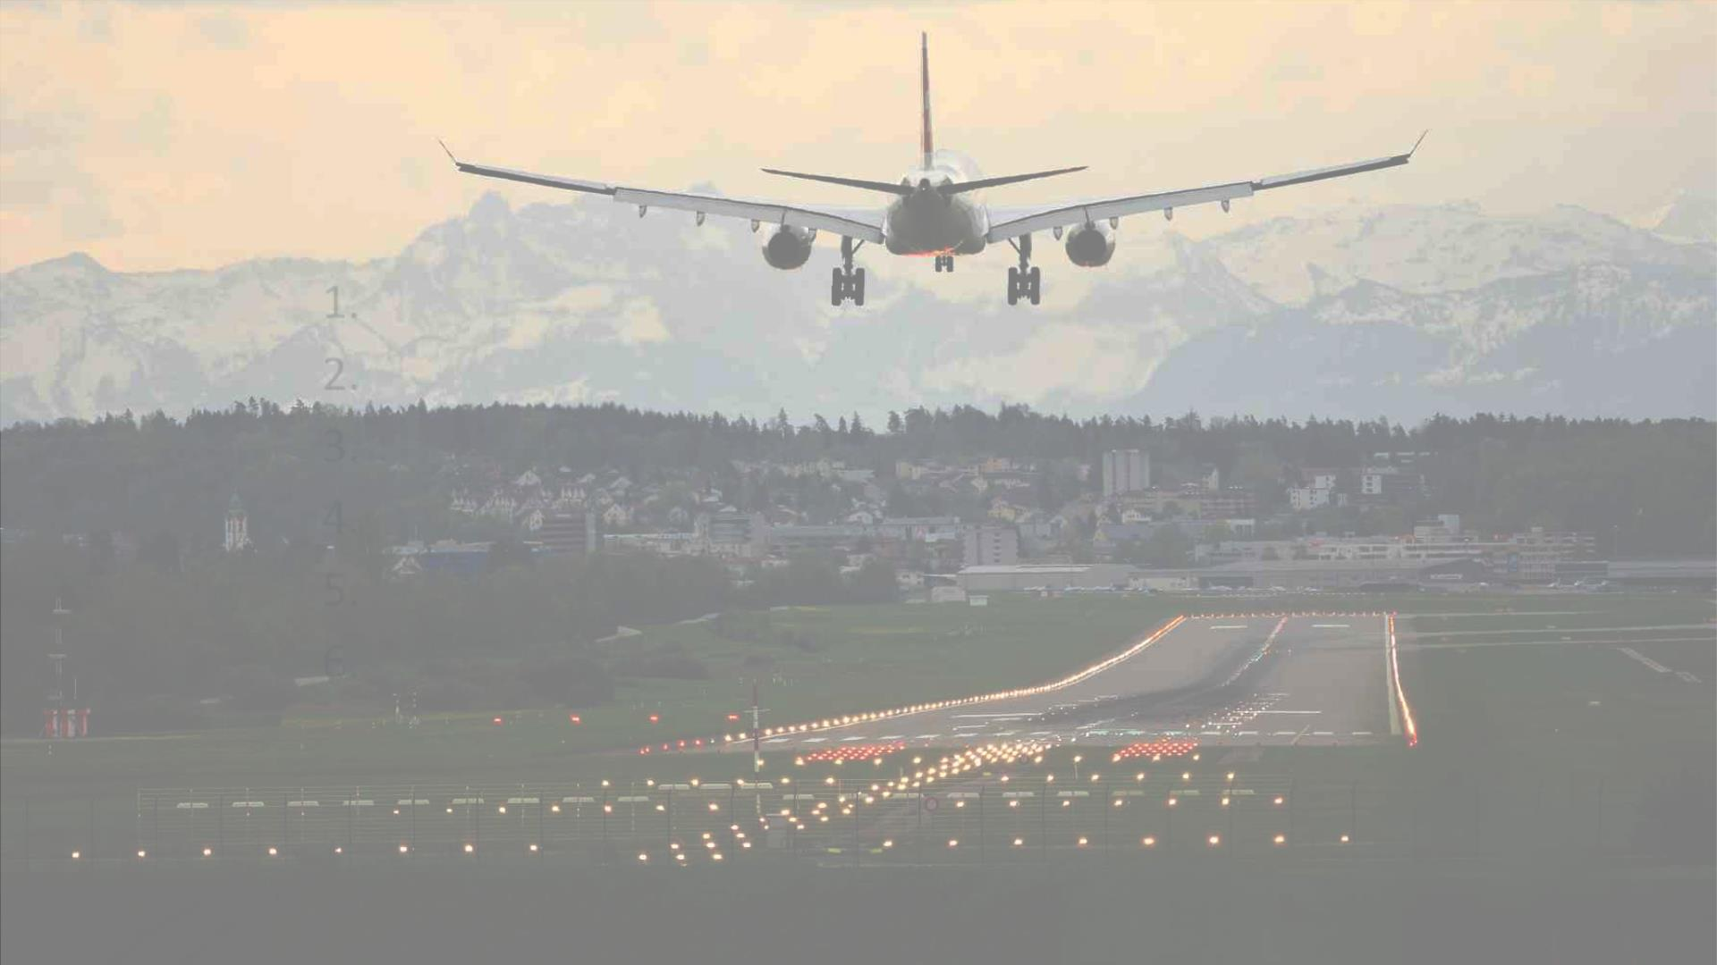
Title
1. Summary Of Review 1
2. Modules Demo
3. Table Creation
4. Data In Database
5. Normalisation
6. ER Diagram

Slide 3
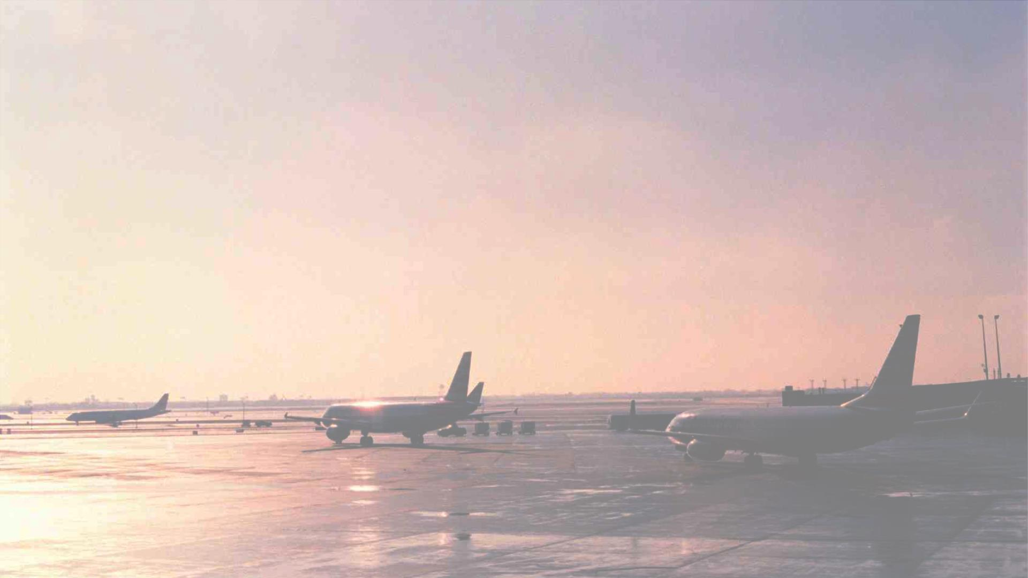
SUMMARY OF REVIEW 1
In Review 1 , we cover these following topics :-
1. Objective
2. Drawback Existing System
3. Need Of DBMS In Project
4. Modules
a) User
b)Admin
c)Tickets e)Staff
d)Airlines
1. ER Diagram
2. Software & Hardware Requirements
3. References
Now we will explore these things in more details

Slide 4
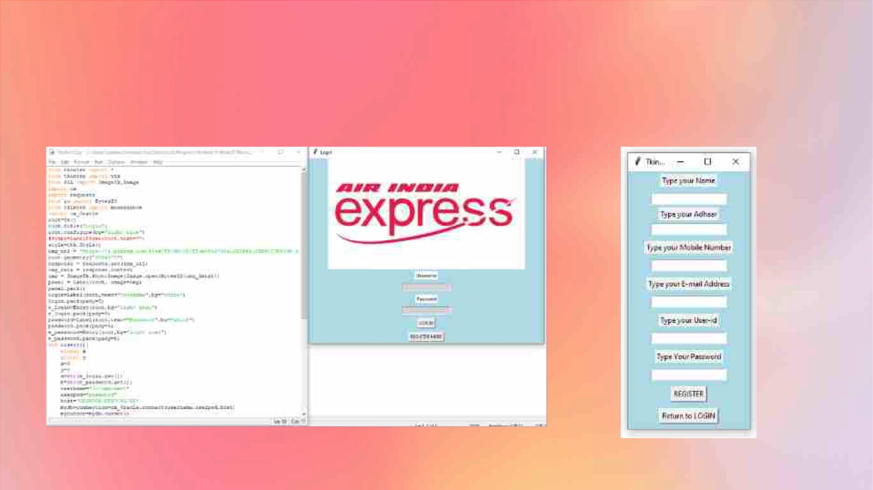
User Module
Here the front end code of User module is shown which is written in Tkinter. We also provide the graphical interface
of it

Slide 5
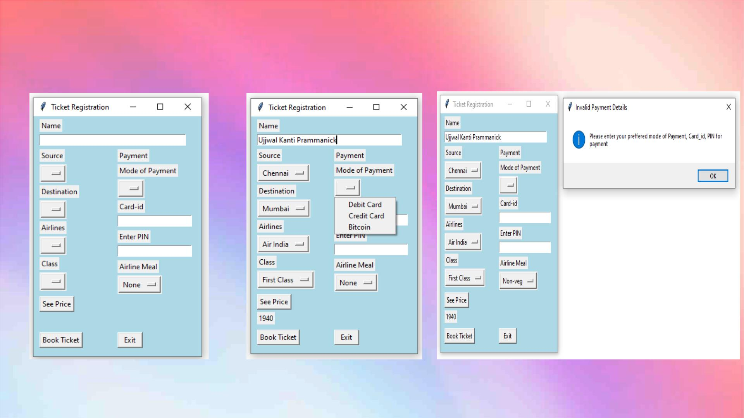
Tickets Module

Slide 6
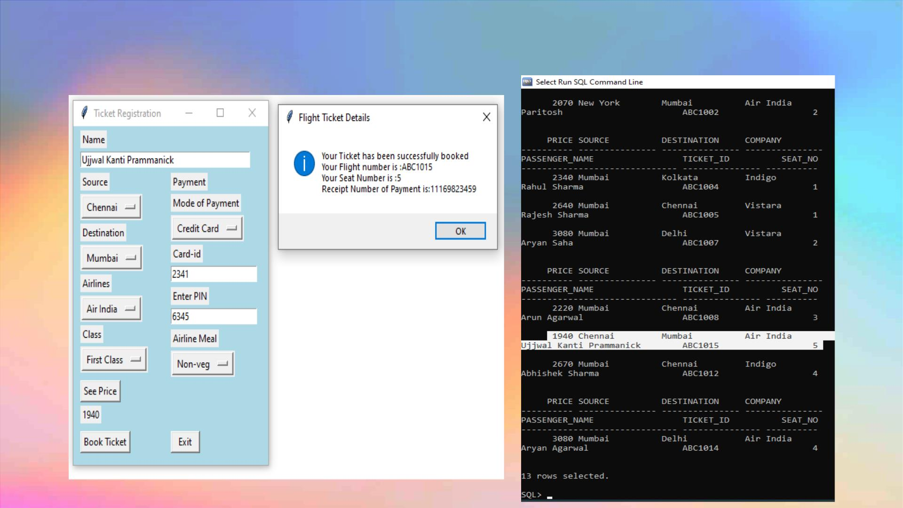
Ticket Module

Slide 7
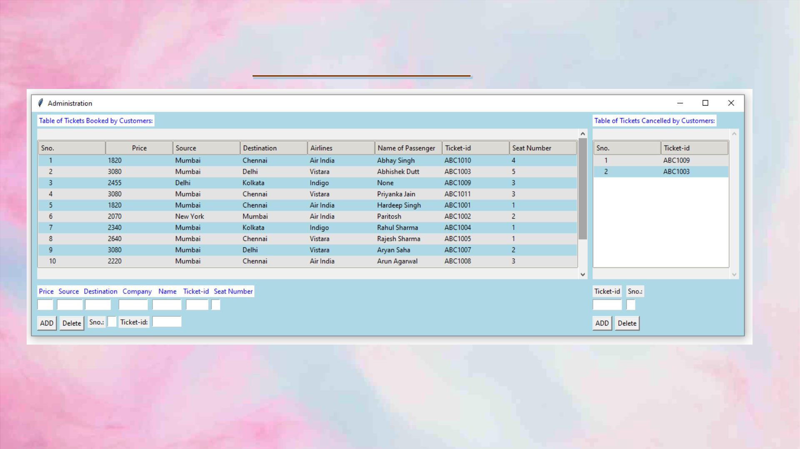
Admin Module

Slide 8
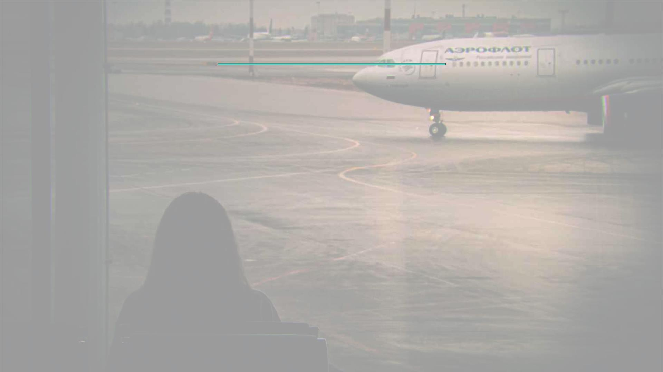
Table Creation
• create table customer(adhaar varchar2(15),mobile_no varchar2(12) not null,name
varchar2(30),email_id varchar2(30),primary key(adhaar));
• create table login(login_id varchar2(15),password varchar2(15),primary
key(login_id));
• create table tickets(price number,source varchar2(15),destination
varchar2(15),company varchar2(15),passenger_name varchar2(30),ticket_id
varchar2(15),seat_no number,primary key(ticket_id));
• create table payment(card_id varchar2(15),pin varchar2(15),type
varchar2(20),recipt_no number(13),ticket_id varchar2(15),primary
key(ticket_id),foreign key(ticket_id) references tickets(ticket_id));
• create table airlines(id varchar2(15),name varchar2(15),city varchar2(15),country
varchar2(15),type varchar2(15),primary key(id));
• create table airport(id varchar2(15),name varchar2(15), city varchar2(15),primary
key(id));
• create table employees(emp_id varchar2(15),name varchar2(15),age number,job
varchar2(15),salary number,primary key(emp_id));

Slide 9
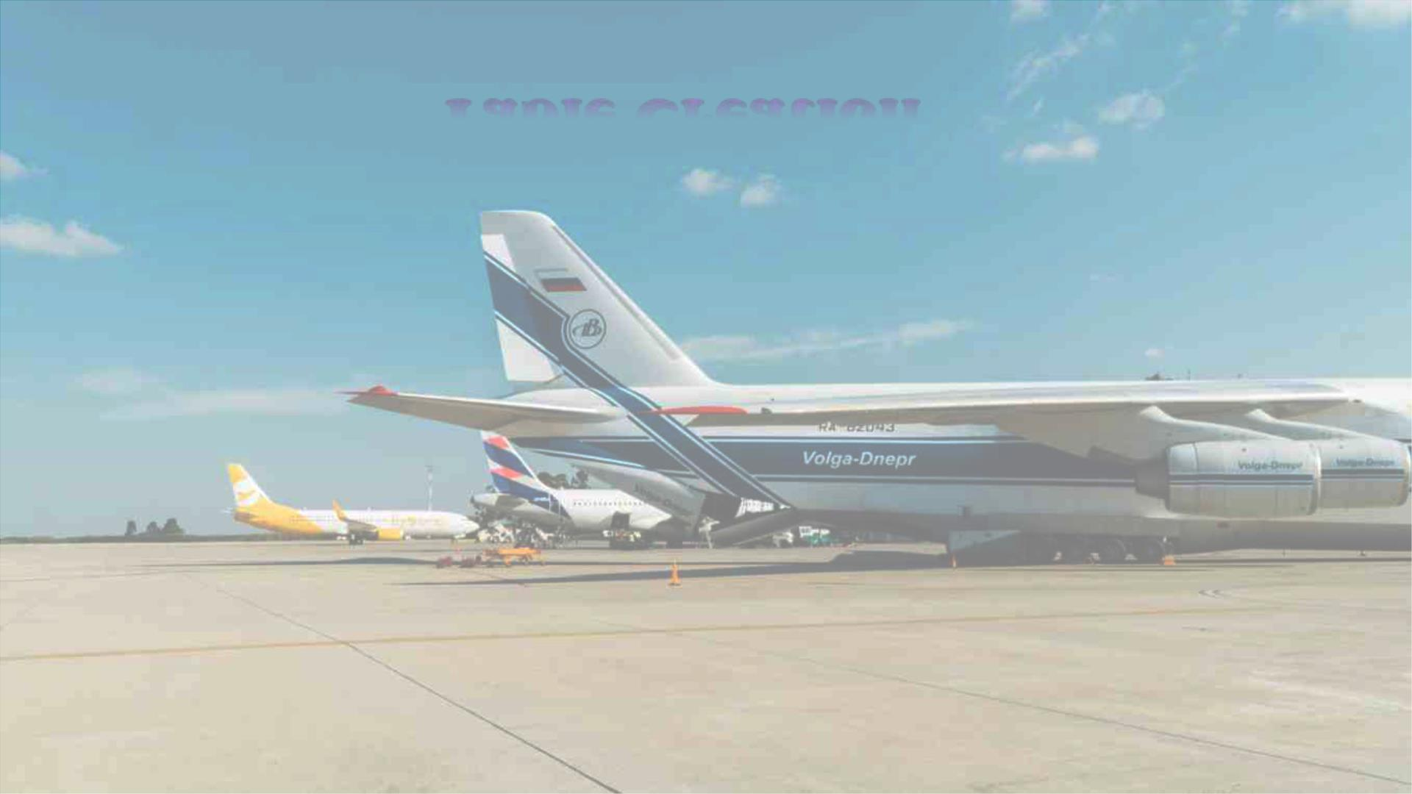
Table Creation
• create table passengers(p_id varchar2(15),name varchar2(15),country
varchar2(15),address varchar2(15),primary key(p_id),foreign key(p_id) references
tickets(ticket_id));
• create table flights(flight_no varchar2(15),luggage_limit_kg number,no_of_seats
number,id varchar2(15),primary key(flight_no),foreign key(id) references
airlines(id));
• create table food_available(item_name varchar2(15),p_id
varchar2(15),flight_no,primary key(p_id),foreign key(p_id) references
passengers(p_id),foreign key(flight_no) references flights(flight_no));
• create table class(type varchar2(20),fare number,flight_no varchar2(15),primary
key(flight_no),foreign key(flight_no) references flights(flight_no));
• create table staff(Pilot_name varchar2(30),Co_pilot_name
varchar2(30),no_of_airstewards number,flight_no varchar2(15),primary
key(flight_no),foreign key(flight_no) references flights(flight_no));
• create table tickets_cancelled(ticket_id varchar2(15) unique);

Slide 10
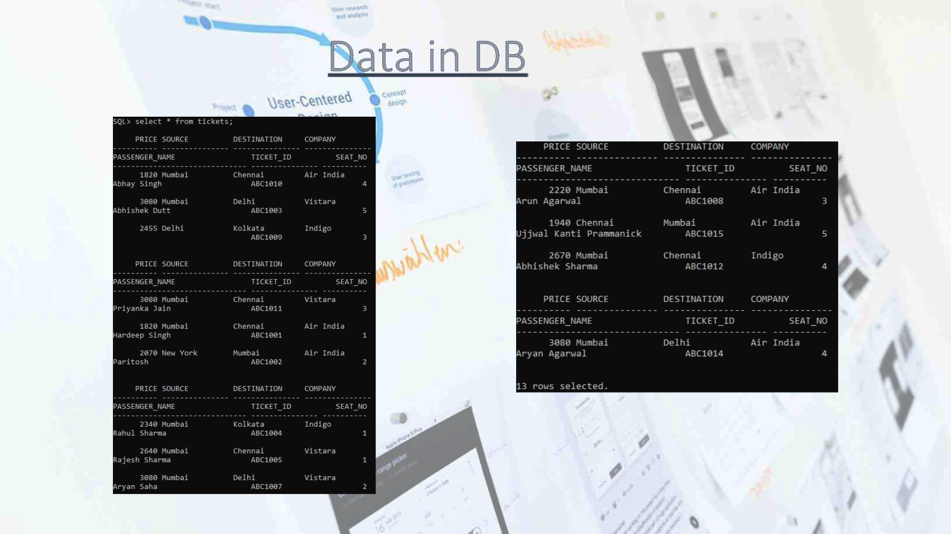
Data in DB
For Table tickets:

Slide 11
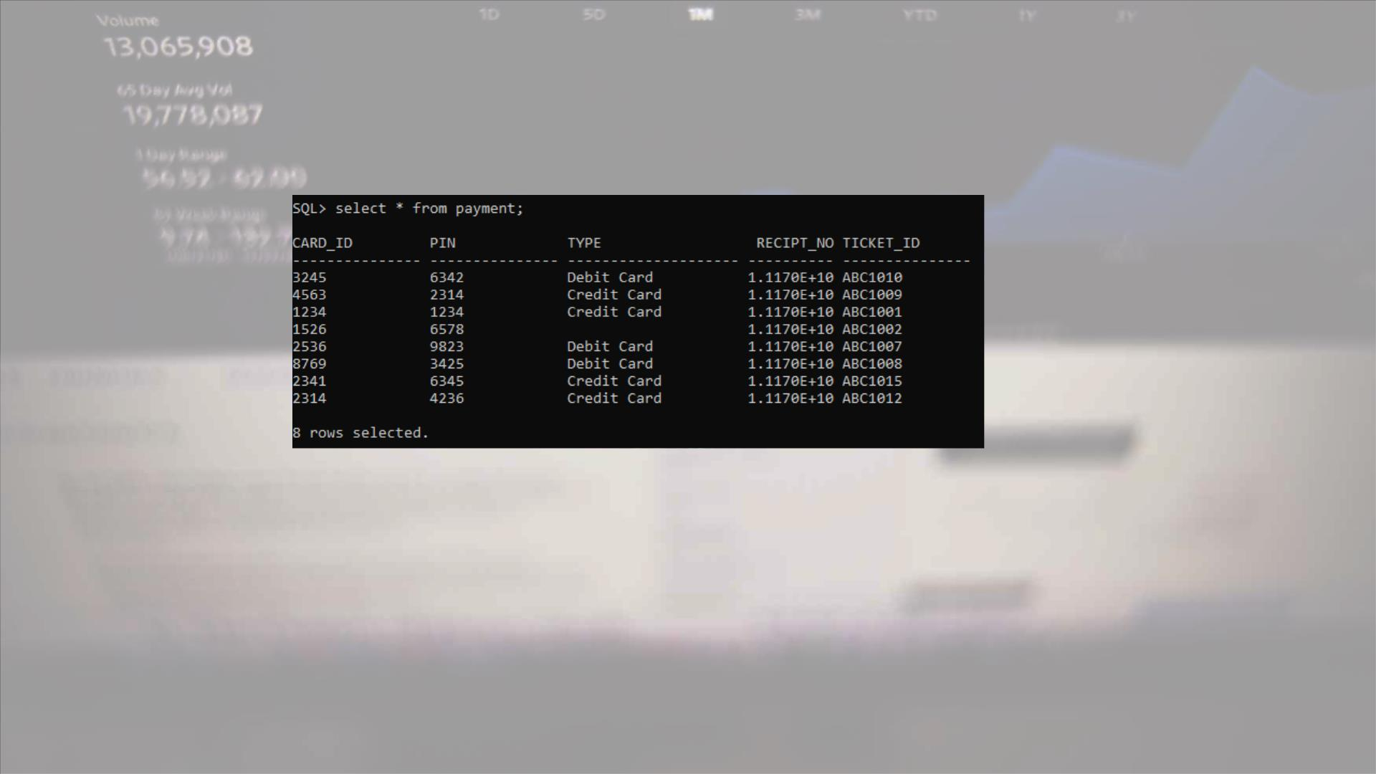
For Table payment:

Slide 12
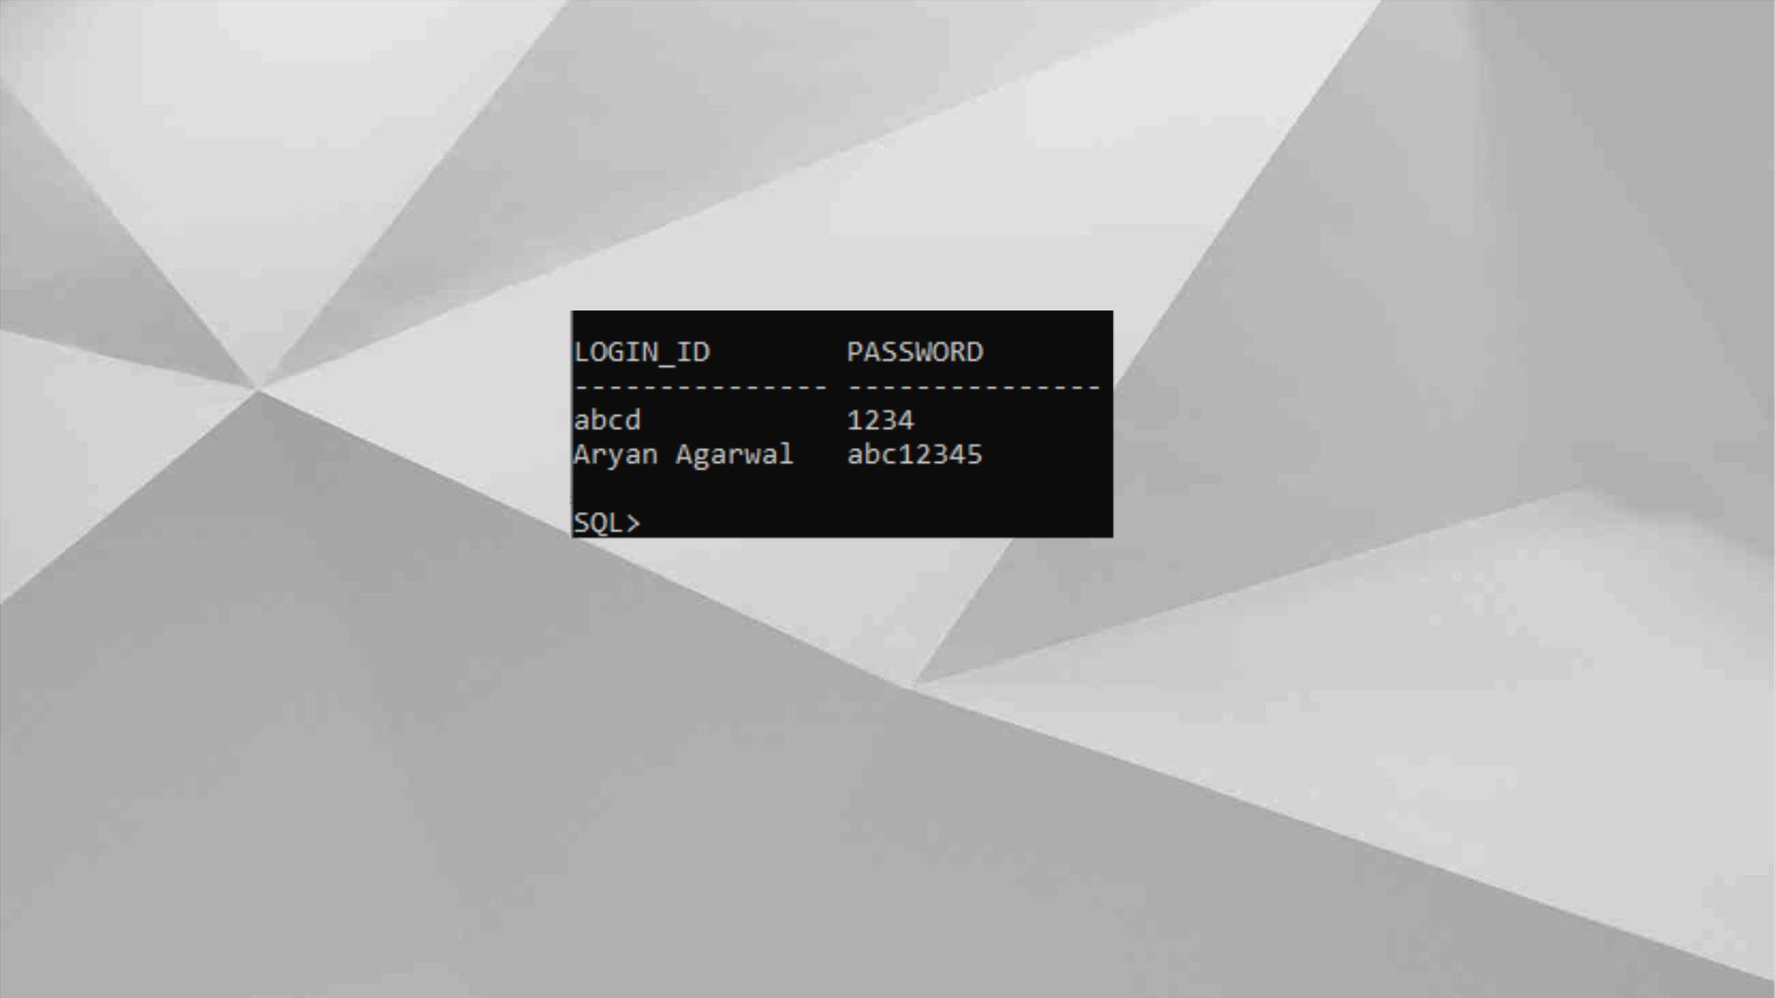
For Table login

Slide 13
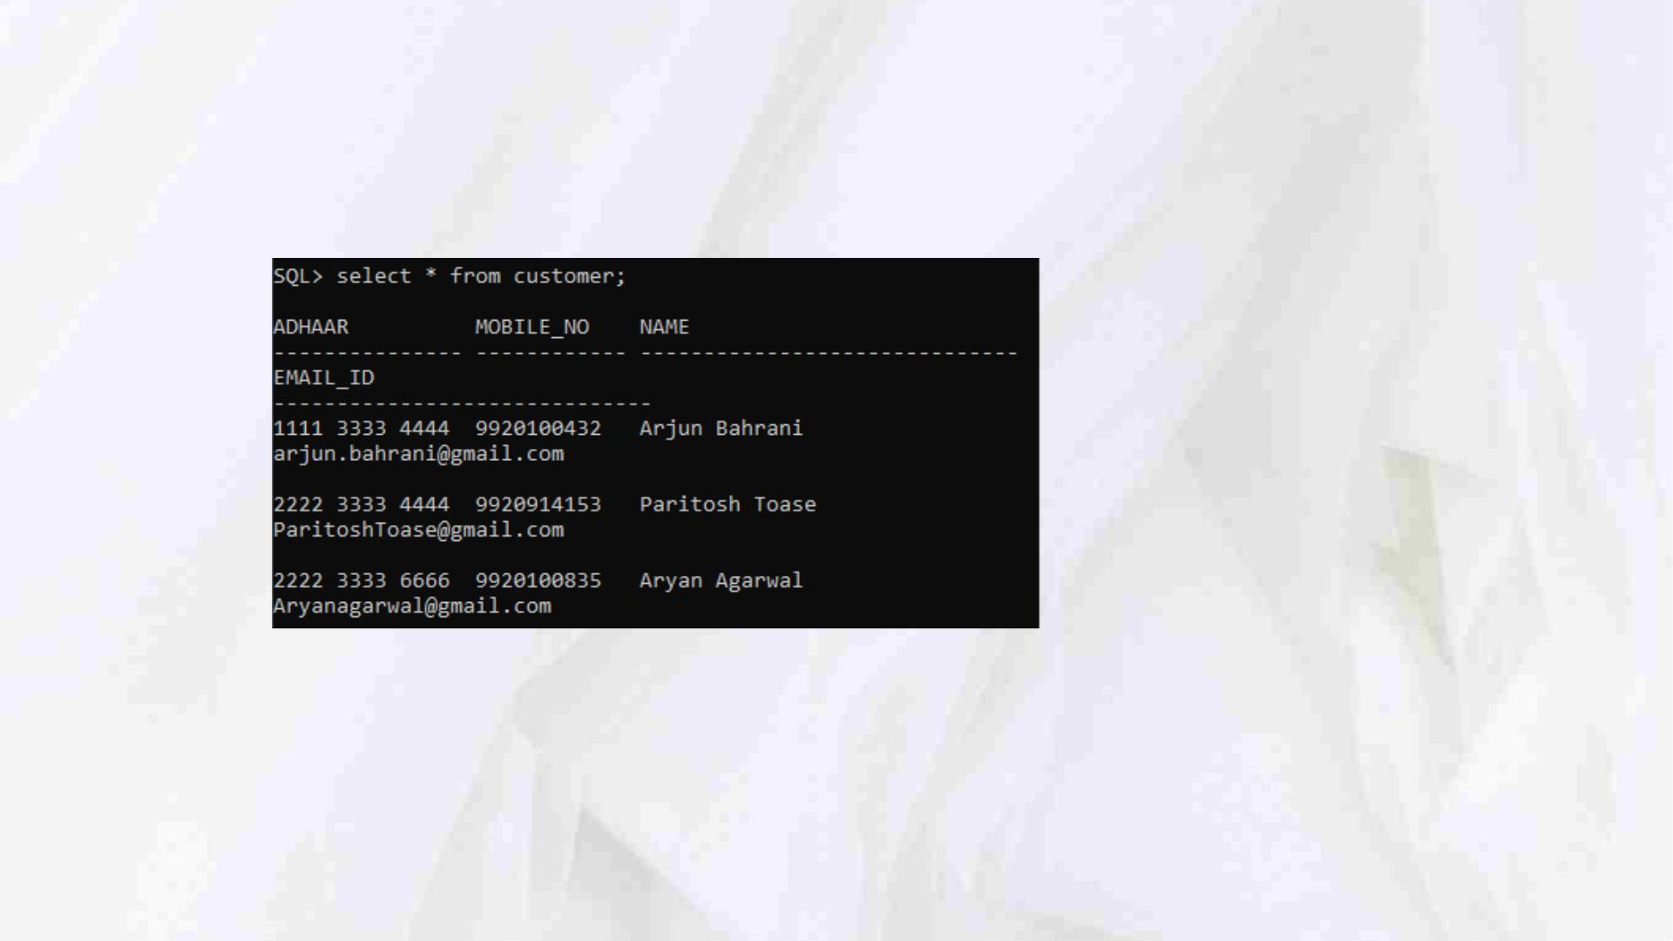
Table customer

Slide 14
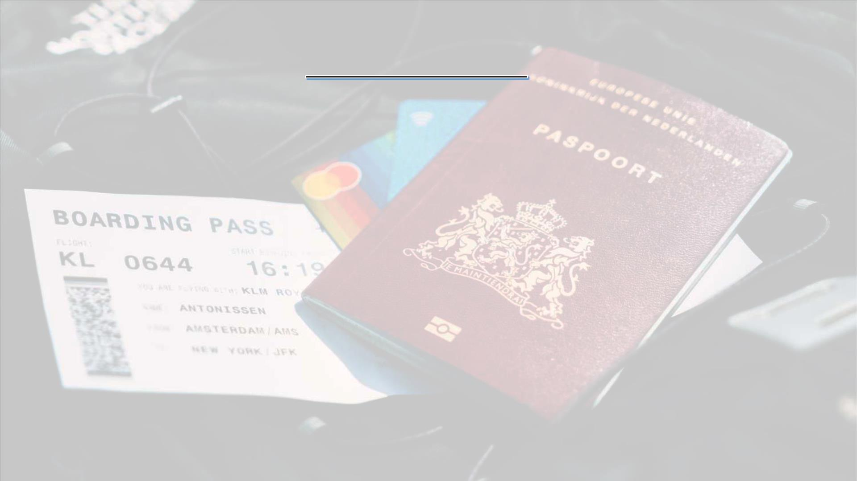
Normalisation
• Normalization reduces redundancy. Redundancy is the unnecessary
repetition of data. It can cause problems with storage, reterival and
updating of data.
• This is done to avoid data redundancy and data inconsistencies
• The types of Normalisation in this project are:
1. 1 NF: Each table cell has single value and every record in the table is
unique.
2. 2 NF: Partial Dependency is removed from the table
3. 3 NF: Transitive and Partial Dependency is removed from the table
4. 4 NF: Partial Dependency, Transitive Dependency and Multivalued
dependency is removed from the table
5. 5 NF: Partial Dependency, Transitive Dependency, Multivalued
dependency and Join Dependency is removed from the table

Slide 15
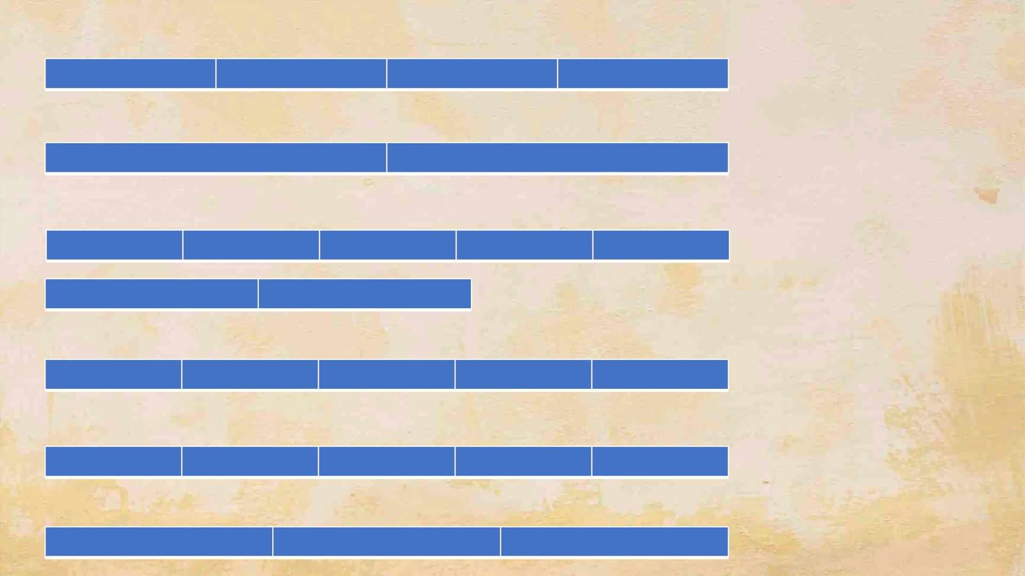
• Table customer is of 3 NF form
Adhaar
Mobile_no
Name
Email_id
• Table login is of 5 NF form
Login_id
Password
• Table tickets is of 3 NF form
Ticket_id
Price
Source
Destination
Compnay
Passenger_name
Seat_no
• Table payment is of 3 NF form
Ticket_id
Card_id
PIN
Type
Receipt_no
Type
• Table airlines is of 3 NF form
ID
Name
City
Country
City
• Table airport is of 3 NF form
ID
Name

Slide 16

• Table flights is of 3NF form
Flight_no
Luggage_limit
No._of_seats
Airline_id
• Table food_available is of 3NF form
Ticket_id
Flight no
Item_name
• Table staff is of 3NF form
Flight_no
Pilot_name
Co-pilot_name
No_of_airstewards
• Table tickets_cancelled
Ticket_id

Slide 17
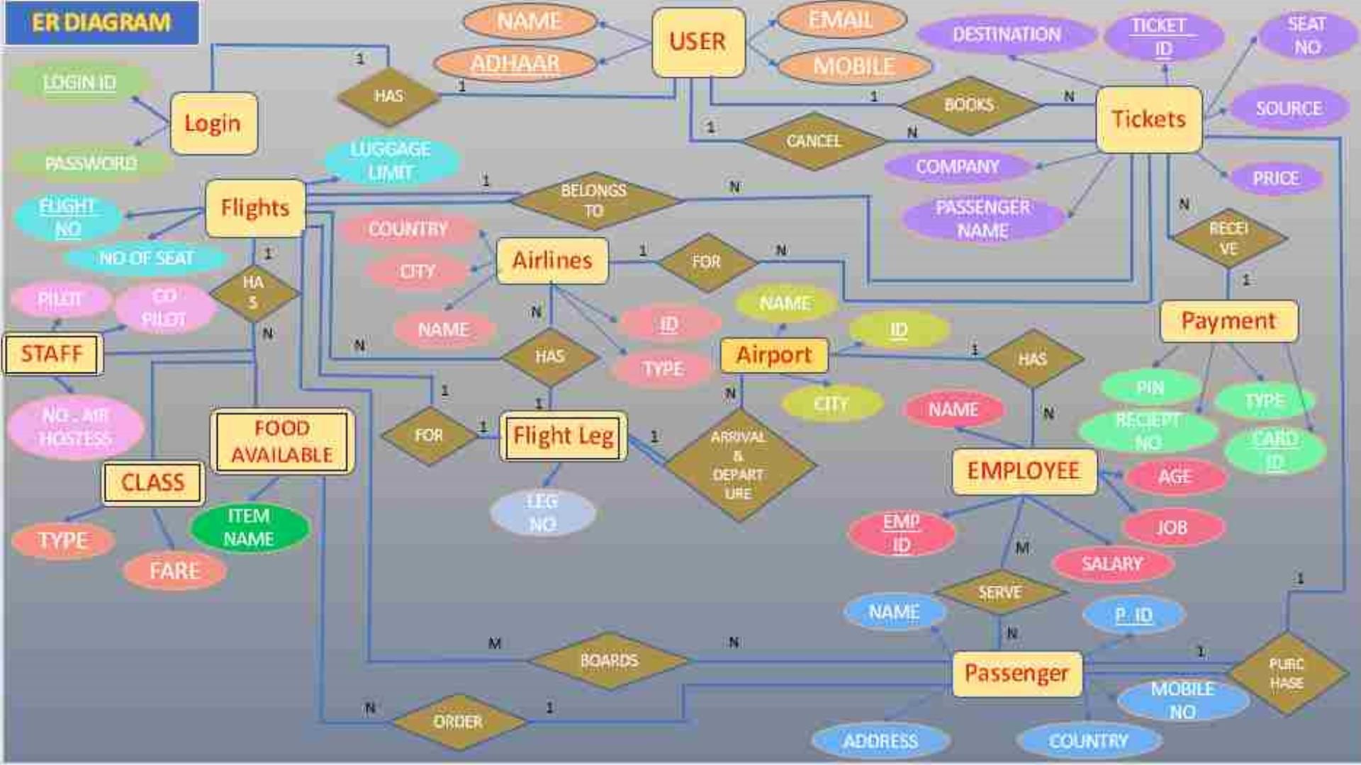

Slide 18

THANK YOU

